Slide 1

Build an ANN Using MATLAB
Professor Bo Liu
James Watt School of Engineering

Slide 2
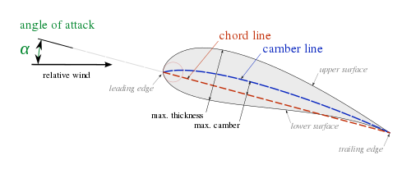

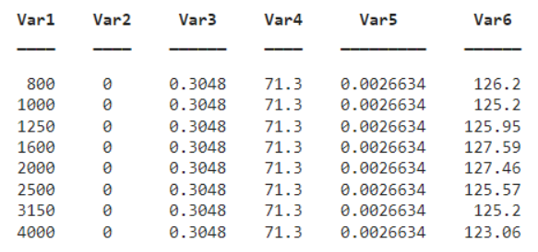
Problem background and dataset description
This problem has the following inputs:
Frequency, in Hertzs.
Angle of attack, in degrees.
Chord length, in meters.
Free-stream velocity, in meters per second.
Suction side displacement thickness, in meters.
The only output is:
Scaled sound pressure level, in decibels.
Learn the sound pressure
See live script

Slide 3
Re-arranging dataset
This problem has the following inputs:
Frequency, in Hertzs.
Angle of attack, in degrees.
Chord length, in meters.
Free-stream velocity, in meters per second.
Suction side displacement thickness, in meters.
The only output is:
Scaled sound pressure level, in decibels.
Related functions:
dividerand
% Spliting the dataset
[trainInd, ~, testInd] = dividerand(size(airfoil_self_noise,1), 0.8, 0, 0.2);
tblTrain = airfoil_self_noise(trainInd,:); % Extracting training sample inputs
tblTest = airfoil_self_noise(testInd,:); % Extracting testing sample inputs
See live script

Slide 4
Construction and training of the network
Neural network construction
simple regression task,
6 inputs and 1 output.
Consider start with simple neural network
1 hidden layer with 20 neurons,
ReLU activation layers.
 |  | … … …

Slide 5
Construction and training of the network
Neural network construction and configuration
layers = [
featureInputLayer(size(tblTrain,2)-1) % input layer: # dim, training data
fullyConnectedLayer(20) % hidden layer: an initial try
reluLayer % ReLU activation func. (not a new layer of neurons)
fullyConnectedLayer(1) % Output layer: # output dim.
regressionLayer("Name","output")];
Neural network construction
simple regression task
6 inputs and 1 output
Consider start with simple neural network
1 hidden layer with 20 neurons
ReLU activation layers
Useful docs:
deep learning layers
Adam optimizer
options = trainingOptions('adam', ... % using adam optimizer
'MaxEpochs',4000, ... % number of epochs of training
'MiniBatchSize', size(tblTrain, 1), ... % batch training
'Shuffle','every-epoch', ... % shuffling the training samples
'Plots','training-progress', ... % visualizing the training process
'ExecutionEnvironment', 'cpu', ... % training on CPU
'Verbose',false); % hide notices while training
Related functions:
featureInputLayer
reluLayer
fullyConnectedLayer
regressionLayer
trainingOptions
trainNetwork
Neural network training
net = trainNetwork(tblTrain, layers, options);
See live script

Slide 6

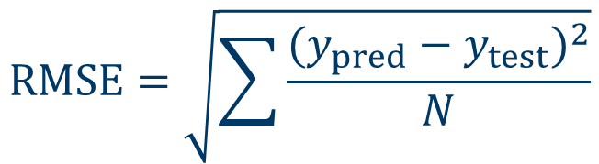
Prediction using the neural network
Predicting the sound pressure levels of the test set
% Predicting y in the test set
y_pred = predict(net,tblTest);
Evaluating the network by calculating the RMSE for the test set
Related functions:
predict
sqrt
$$RMSE=\sqrt{\sum{\frac{{(y_{pred}−y_{test})}^{2}}{N}}}$$
% Calculating the root-mean-squred-error
rmse = sqrt(sum((y_pred - tblTest.Var6).^2, 'all')/length(tblTest.Var6))
See live script

Slide 7

Improving the network
Improving the network structure by adding normalization
layers = [
featureInputLayer(size(tblTrain, 2)-1, "Normalization","rescale-zero-one")
fullyConnectedLayer(20) % hidden layer: an initial try
reluLayer % ReLU activation func. (not a new layer of neurons)
fullyConnectedLayer(1) % Output layer: # output dim.
regressionLayer("Name","output")];
% Configuring the training options
options = trainingOptions('adam', ... % using adam optimizer
'MaxEpochs',5000, ... % more epochs of training
'MiniBatchSize', size(tblTrain, 1), ... % batch training
'Shuffle','every-epoch', ... % shuffling the training samples
'Plots','training-progress', ... % visualizing the training process
'ExecutionEnvironment', 'cpu', ... % training on CPU
'Verbose',false); % hide notices while training
Useful documentation:
normalization
net = trainNetwork(tblTrain, layers, options);
% Predicting y in the test set
y_pred = predict(net,tblTest);
% Calculating the root-mean-squred-error
rmse = sqrt(sum((y_pred - tblTest.Var6).^2, 'all')/length(tblTest.Var6))
RMSE reduced!
See live script

Slide 8

Improving the network
Improving the network structure by making it deeper and wider
layers = [
featureInputLayer(size(tblTrain,2)-1,"Normalization","rescale-zero-one")
fullyConnectedLayer(40) % more neurons in hidden layer
reluLayer % ReLU activation func. (not a new layer of neurons)
fullyConnectedLayer(40) % more neurons in hidden layer
reluLayer % ReLU activation func. (not a new layer of neurons)
fullyConnectedLayer(1) % Output layer: # output dim.
regressionLayer("Name","output")];
% Configuring the training options
options = trainingOptions('adam', ...
'MaxEpochs',5000, ... % more epochs of training
'MiniBatchSize', size(tblTrain, 1), ... % batch training
'Shuffle','every-epoch', ... % shuffling the training samples
'Plots','training-progress', ... % visualizing the training process
'ExecutionEnvironment', 'cpu', ... % training on CPU
'Verbose',false); % hide notices while training
Useful documentation:
normalization
% Training the neural network
net = trainNetwork(tblTrain, layers, options);
RMSE further reduced!
% Predicting y in the test set
y_pred = predict(net,tblTest);
% Calculating the root-mean-squred-error
rmse = sqrt(sum((y_pred - tblTest.Var6).^2, 'all')/length(tblTest.Var6))
See live script

Slide 9




Thanks!
#UofGWorldChangers
@UofGlasgow

